Slide 1
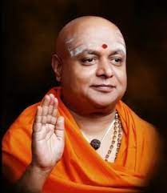
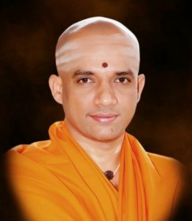


|| Jai Sri Gurudev||
ADICHUNCHANAGIRI UNIVERSITY
FACULTY OF ENGINEERING AND TECHNOLOGY
(BGS INSTITUTE OF TECHNOLOGY)
BG Nagara, Nagamangala Taluk, Mandya District, Karnataka, India-571448
Tel: 08234-28841-419, Web: www.bgsit.ac.in
Project Phase-2 Presentation
On
“Remote Controlled Unmanned Ground and Aerial Vehicle (UGAV) for Waste Disposal”
BACHELOR OF ENGINEERING
IN
ELECTRONICS AND COMMUNICATION ENGINEERING
Presented by:
Chandana R(22ECE019)
Nagashree M(22ECE094)
Nishanth S(22ECE099)
Under the guidance of:
Mrs. Ramya K, _{BE, MTech(Ph.D).}
Assistant Professor, Dept. of ECE,
BGSIT, BG Nagara, Mandya
03 June 2026

Slide 2
|| Jai Sri Gurudev||
ADICHUNCHANAGIRI UNIVERSITY
FACULTY OF ENGINEERING AND TECHNOLOGY
(BGS INSTITUTE OF TECHNOLOGY)
BG Nagara, Nagamangala Taluk, Mandya District, Karnataka, India-571448
Tel: 08234-28841-419, Web: www.bgsit.ac.in
Contents:
1.Abstract.
2.Introduction.
3.Problem Definition.
4.Literature survey.
5.Objectives.
6.Hardware/Software Requirments.
7.Block Diagram.
8.Methodology.
9.Flow chart
10.Results
11.conclusions
12.References.
1

Slide 3
|| Jai Sri Gurudev||
ADICHUNCHANAGIRI UNIVERSITY
FACULTY OF ENGINEERING AND TECHNOLOGY
(BGS INSTITUTE OF TECHNOLOGY)
BG Nagara, Nagamangala Taluk, Mandya District, Karnataka, India-571448
Tel: 08234-28841-419, Web: www.bgsit.ac.in
1. Abstract:
Unmanned aerial and ground vehicles are widely used today in military and space research.
Normal robotic vacuum cleaners work only on flat ground and cannot overcome obstacles.
To solve this problem, we designed a UGAV (Unmanned Ground and Aerial Vehicle) with a vacuum cleaning in a single system.
The vehicle has three functions: Flying (Drone mode), Driving (Rover mode), Vacuum cleaning
The system can be controlled remotely from a distance .It saves energy by switching between flying and driving modes depending on the situation.
After cleaning, the vehicle can fly to a disposal area to empty collected dust.
The vacuum cleaner collects lightweight dry waste such as dust, paper pieces, dry leaves, and plastic wrappers.
.
2

Slide 4
|| Jai Sri Gurudev||
ADICHUNCHANAGIRI UNIVERSITY
FACULTY OF ENGINEERING AND TECHNOLOGY
(BGS INSTITUTE OF TECHNOLOGY)
BG Nagara, Nagamangala Taluk, Mandya District, Karnataka, India-571448
Tel: 08234-28841-419, Web: www.bgsit.ac.in
2. Introduction:
Waste collection and disposal is an important challenge in cities, industries, railway stations, and public places.
Manual cleaning requires more time, effort, and may expose workers to hazardous waste and unhealthy environments.
Existing cleaning robots are mostly limited to flat surfaces and cannot easily handle stairs, obstacles, or rough terrains.
New intelligent robots with wireless internet improve interaction with users.
Hybrid robotic platforms combining aerial and ground mobility provide better flexibility and accessibility in complex environments.
Unmanned Ground and Aerial Vehicle(UGAV) combines UAV (flying) and UGV (driving) into one machine.
3

Slide 5
|| Jai Sri Gurudev||
ADICHUNCHANAGIRI UNIVERSITY
FACULTY OF ENGINEERING AND TECHNOLOGY
(BGS INSTITUTE OF TECHNOLOGY)
BG Nagara, Nagamangala Taluk, Mandya District, Karnataka, India-571448
Tel: 08234-28841-419, Web: www.bgsit.ac.in
3. Problem Definition:
Manual waste collection in hazardous, dirty, and hard-to-reach areas is often time-consuming, risky, and inefficient. Existing vacuum cleaners are limited to flat surfaces, while drones cannot perform cleaning operations effectively. Therefore, a hybrid UGAV system is proposed to collect waste on the ground and fly over obstacles for safe and efficient waste disposal.
4

Slide 6
|| Jai Sri Gurudev||
ADICHUNCHANAGIRI UNIVERSITY
FACULTY OF ENGINEERING AND TECHNOLOGY
(BGS INSTITUTE OF TECHNOLOGY)
BG Nagara, Nagamangala Taluk, Mandya District, Karnataka, India-571448
Tel: 08234-28841-419, Web: www.bgsit.ac.in
4. Literature survey:
Sl.No | Author | Title | Year | Description
1 | T. Bright & S. Adali | The Application of AI Powered Drone Technology with Computer Vision and Deep Learning Networks in Waste Management | 2025 | Discussed AI-enabled drones for waste monitoring and management applications.
2 | D.D. Sharma & J. Lin | Secure Learning-Based Coordinated UAV–UGV Framework Design for Medical Waste Transportation | 2024 | Proposed a coordinated UAV–UGV system for safe medical waste transportation.
3 | I. Munasinghe et al. | A Comprehensive Review of UAV–UGV Collaboration: Advancements and Challenges | 2024 | Reviewed various UAV–UGV collaborative systems, their applications, advantages, and challenges in real-world environments.
4 | Z. Ren et al. | Review of UAV, UGV, and collaborative systems. | 2022 | Integrated cleaning, storage, and waste disposal mechanisms.
5

Slide 7
|| Jai Sri Gurudev||
ADICHUNCHANAGIRI UNIVERSITY
FACULTY OF ENGINEERING AND TECHNOLOGY
(BGS INSTITUTE OF TECHNOLOGY)
BG Nagara, Nagamangala Taluk, Mandya District, Karnataka, India-571448
Tel: 08234-28841-419, Web: www.bgsit.ac.in
To design and develop a hybrid robot capable of flying, driving, and vacuum-cleaning operations.
To develop a waste collection mechanism for picking and disposing of dust and small waste particles efficiently.
To design a lightweight and compact structure suitable for stable aerial and ground mobility.
To enable remote-controlled operation for monitoring and controlling the vehicle from distant locations.
To improve cleaning efficiency in hard-to-reach and hazardous environments using hybrid UAV–UGV technology.
To reduce human effort and exposure during waste disposal.
5. Objectives:
6

Slide 8
|| Jai Sri Gurudev||
ADICHUNCHANAGIRI UNIVERSITY
FACULTY OF ENGINEERING AND TECHNOLOGY
(BGS INSTITUTE OF TECHNOLOGY)
BG Nagara, Nagamangala Taluk, Mandya District, Karnataka, India-571448
Tel: 08234-28841-419, Web: www.bgsit.ac.in
6. Methodology:
The system is designed as a hybrid cleaning robot that can move both on the ground and in the air. It combines drone-like multirotor propellers for flying and a wheeled rover mechanism for ground movement. vacuum unit with a brushless motor, filter, and dust bin is attached to the rover to collect dust and lightweight waste materials.
For control and navigation, the robot can easily switch between ground mode and flight mode using a mode management system, making sure the transition is safe. It is operated remotely using the MAV Link protocol, which allows the user to control the movement, vacuum, and flying path.
It is remotely controlled using a FlySky transmitter and Pixhawk flight controller, allowing the user to control movement, cleaning, and navigation.
Finally, for testing and evaluation, the prototype will be tested in areas with different levels and obstacles to check how well it works.
7

Slide 9
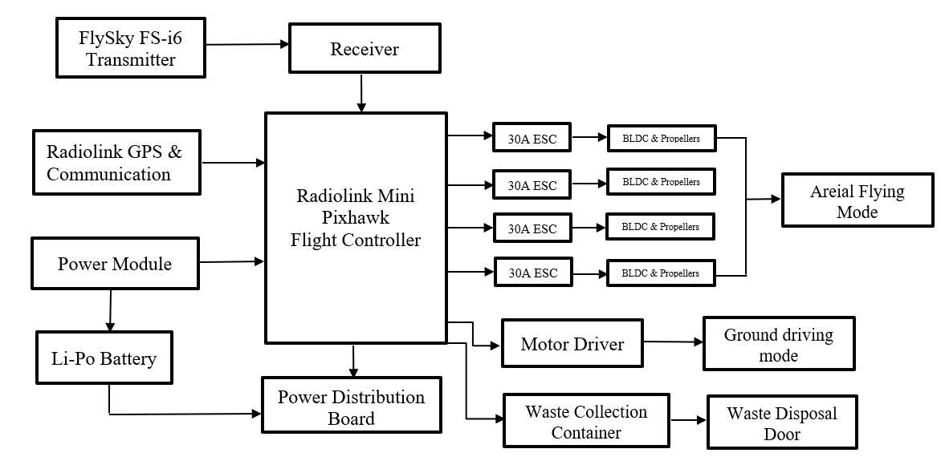
|| Jai Sri Gurudev||
ADICHUNCHANAGIRI UNIVERSITY
FACULTY OF ENGINEERING AND TECHNOLOGY
(BGS INSTITUTE OF TECHNOLOGY)
BG Nagara, Nagamangala Taluk, Mandya District, Karnataka, India-571448
Tel: 08234-28841-419, Web: www.bgsit.ac.in
b
7. Block Diagram:
Figure 1: Block Diagram of remote controlled UGAV for waste disposal.
8

Slide 10
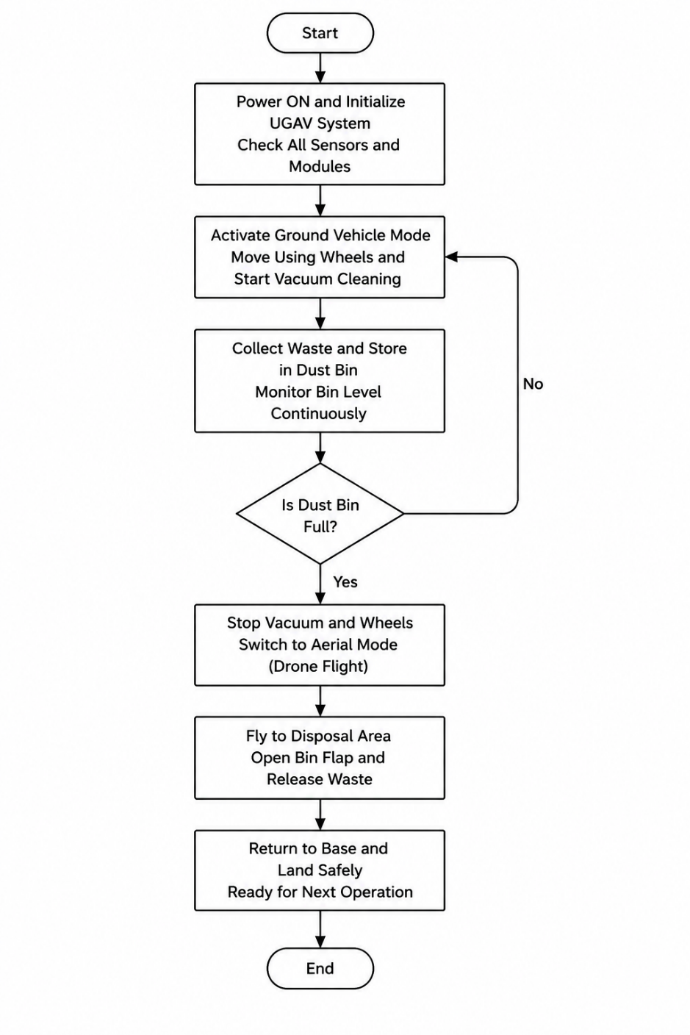
|| Jai Sri Gurudev||
ADICHUNCHANAGIRI UNIVERSITY
FACULTY OF ENGINEERING AND TECHNOLOGY
(BGS INSTITUTE OF TECHNOLOGY)
BG Nagara, Nagamangala Taluk, Mandya District, Karnataka, India-571448
Tel: 08234-28841-419, Web: www.bgsit.ac.in
8.Flow Chart:
9
Figure 2:Flow Chart of Remote Controlled UGAV for Waste Disposal

Slide 11
|| Jai Sri Gurudev||
ADICHUNCHANAGIRI UNIVERSITY
FACULTY OF ENGINEERING AND TECHNOLOGY
(BGS INSTITUTE OF TECHNOLOGY)
BG Nagara, Nagamangala Taluk, Mandya District, Karnataka, India-571448
Tel: 08234-28841-419, Web: www.bgsit.ac.in
9. Hardware/Software Requirements:
Hardware
1. Airframe and Mobility System
Quadrotor Frame
4 × BLDC Motors + 4 × ESCs
4 × Propellers
Rover Base (4 Wheels)
DC Gear Motors
2. Compute and Control System
Mini Pix (Pixhawk) Flight Controller
FlySky Transmitter & Receiver
3. Navigation and Positioning System
GPS Module
10

Slide 12
|| Jai Sri Gurudev||
ADICHUNCHANAGIRI UNIVERSITY
FACULTY OF ENGINEERING AND TECHNOLOGY
(BGS INSTITUTE OF TECHNOLOGY)
BG Nagara, Nagamangala Taluk, Mandya District, Karnataka, India-571448
Tel: 08234-28841-419, Web: www.bgsit.ac.in
4. Waste Collection and Disposal System
Vacuum Motor
Dust Collection Container
Servo Motor (Waste Disposal Door)
5. Communication and Power System
WeMos D1 Mini (ESP8266)
Li-Po Battery
Software
Mission Planner – Configuration and Monitoring
ArduPilot Firmware – Flight Control and navigation
Telemetry Interface – Wireless data Communication
11

Slide 13
Mini Pix Flight Controller- Controls and stabilizes the UGAV.
Li-Po Battery- Provides power to the entire system.
BLDC Motors with Propellers- Generate thrust for aerial flight.
Electronic Speed Controller (ESC)- Controls the speed of BLDC motors.
Rover Base with DC Gear Motors- Enables ground movement.
GPS Module- Provides location and navigation data.
FlySky Transmitter & Receiver- Enables wireless remote control.
Vacuum Motor & Dust Container- Collects and stores waste.
Servo Motor- Controls waste disposal.
|| Jai Sri Gurudev||
ADICHUNCHANAGIRI UNIVERSITY
FACULTY OF ENGINEERING AND TECHNOLOGY
(BGS INSTITUTE OF TECHNOLOGY)
BG Nagara, Nagamangala Taluk, Mandya District, Karnataka, India-571448
Tel: 08234-28841-419, Web: www.bgsit.ac.in
10.Components Description:
12

Slide 14
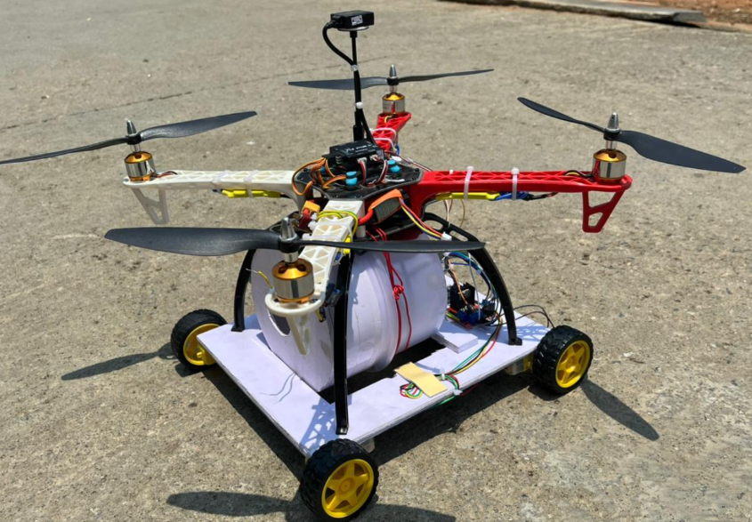
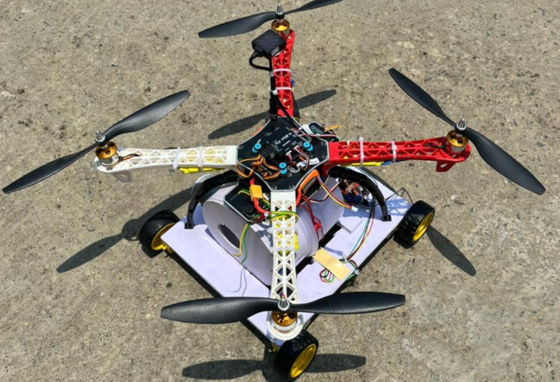
|| Jai Sri Gurudev||
ADICHUNCHANAGIRI UNIVERSITY
FACULTY OF ENGINEERING AND TECHNOLOGY
(BGS INSTITUTE OF TECHNOLOGY)
BG Nagara, Nagamangala Taluk, Mandya District, Karnataka, India-571448
Tel: 08234-28841-419, Web: www.bgsit.ac.in
11.Results:
Figure 1: Side view of UGAV
Figure 2: Top view of UGAV
13

Slide 15
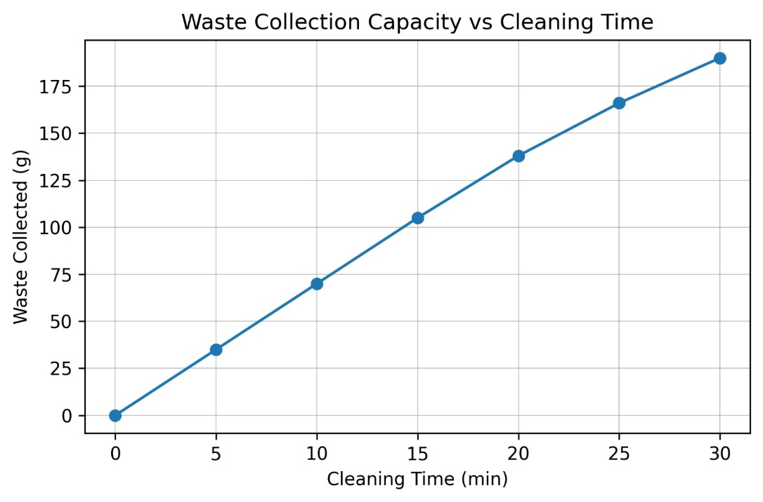
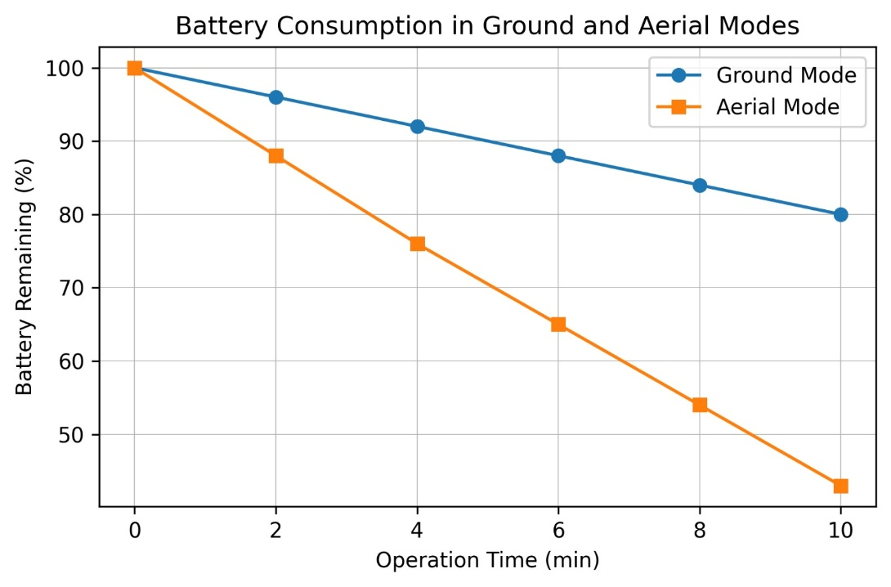
|| Jai Sri Gurudev||
ADICHUNCHANAGIRI UNIVERSITY
FACULTY OF ENGINEERING AND TECHNOLOGY
(BGS INSTITUTE OF TECHNOLOGY)
BG Nagara, Nagamangala Taluk, Mandya District, Karnataka, India-571448
Tel: 08234-28841-419, Web: www.bgsit.ac.in
Figure 3: Cleaning efficiency vs Time
Figure 4: Battery Consumption in Ground and Aerial mode
14

Slide 16
|| Jai Sri Gurudev||
ADICHUNCHANAGIRI UNIVERSITY
FACULTY OF ENGINEERING AND TECHNOLOGY
(BGS INSTITUTE OF TECHNOLOGY)
BG Nagara, Nagamangala Taluk, Mandya District, Karnataka, India-571448
Tel: 08234-28841-419, Web: www.bgsit.ac.in
12.Advantages and Disadvantages
that ensures optimal energy distribution during operation.
Advantages
Reduces human exposure to hazardous and contaminated waste environments.
Enables efficient and faster waste collection in hard-to-reach areas.
Improves cleanliness and sanitation through automated waste handling.
Provides real-time monitoring and remote operation for better control and safety.
Supports smart and sustainable waste management solutions.
Disadvantages
High initial cost for development and maintenance of the UGAV system.
Limited battery life may reduce continuous operating time.
Performance may be affected by strong winds and adverse weather conditions.
15

Slide 17
|| Jai Sri Gurudev||
ADICHUNCHANAGIRI UNIVERSITY
FACULTY OF ENGINEERING AND TECHNOLOGY
(BGS INSTITUTE OF TECHNOLOGY)
BG Nagara, Nagamangala Taluk, Mandya District, Karnataka, India-571448
Tel: 08234-28841-419, Web: www.bgsit.ac.in
13.Applications:
that ensures optimal energy distribution during operation.
Waste collection and disposal in urban and public areas.
Cleaning operations in hazardous industrial environments.
Disaster management and waste removal in affected zones.
Can be deployed in hospitals, railway stations, and smart cities.
Remote cleaning and monitoring in military or restricted areas.
16

Slide 18
|| Jai Sri Gurudev||
ADICHUNCHANAGIRI UNIVERSITY
FACULTY OF ENGINEERING AND TECHNOLOGY
(BGS INSTITUTE OF TECHNOLOGY)
BG Nagara, Nagamangala Taluk, Mandya District, Karnataka, India-571448
Tel: 08234-28841-419, Web: www.bgsit.ac.in
14.Conclusion:
that ensures optimal energy distribution during operation.
Remote-controlled UAVs help make waste disposal easier and faster by reaching places that are hard or unsafe for people to clean, such as high areas or polluted zones.
They keep workers safe because there is no need for them to touch or go near dangerous or harmful waste materials.
Using UAVs can save both time and money since they can collect, monitor, and move waste without needing many workers.
These UAVs also help keep the environment clean by reducing illegal dumping and ensuring that waste is properly handled and disposed off.
In the future, adding smart technologies like sensors and artificial intelligence can make UAVs even more effective for safe and smart waste management.
17

Slide 19
|| Jai Sri Gurudev||
ADICHUNCHANAGIRI UNIVERSITY
FACULTY OF ENGINEERING AND TECHNOLOGY
(BGS INSTITUTE OF TECHNOLOGY)
BG Nagara, Nagamangala Taluk, Mandya District, Karnataka, India-571448
Tel: 08234-28841-419, Web: www.bgsit.ac.in
Future Scope:
that ensures optimal energy distribution during operation.
Integration of Artificial Intelligence (AI) for autonomous navigation and smart cleaning.
Implementation of IoT technology for real-time monitoring and remote management.
Addition of waste segregation mechanisms for automatic dry and wet waste separation.
Improvement in battery capacity and solar charging for longer operation time.
Deployment in smart cities, hospitals, industries, and disaster management areas for advanced waste management.
Integration of Artificial Intelligence (AI) for autonomous navigation and smart cleaning.
18

Slide 20
|| Jai Sri Gurudev||
ADICHUNCHANAGIRI UNIVERSITY
FACULTY OF ENGINEERING AND TECHNOLOGY
(BGS INSTITUTE OF TECHNOLOGY)
BG Nagara, Nagamangala Taluk, Mandya District, Karnataka, India-571448
Tel: 08234-28841-419, Web: www.bgsit.ac.in
References:
[1] T. Bright and S. Adali, "The Application of AI Powered Drone Technology with Computer Vision and Deep Learning Networks in Waste Management," Drones, 2025.DOI: 10.3390/drones9080550
[2] D. D. Sharma and J. Lin, "Secure Learning-Based Coordinated UAV–UGV Framework Design for Medical Waste Transportation," Frontiers in Remote Sensing, 2024.DOI: 10.3389/frsen.2024.1351703
[3] I. Munasinghe et al., "A Comprehensive Review of UAV–UGV Collaboration: Advancements and Challenges," Drones, 2024.
[4] Z. Ren et al., "Integrating UAV, UGV and UAV–UGV Collaboration in Future Smart Agriculture: Review and Outlook," Computers and Electronics in Agriculture, 2024.
19

Slide 21
|| Jai Sri Gurudev||
ADICHUNCHANAGIRI UNIVERSITY
FACULTY OF ENGINEERING AND TECHNOLOGY
(BGS INSTITUTE OF TECHNOLOGY)
BG Nagara, Nagamangala Taluk, Mandya District, Karnataka, India-571448
Tel: 08234-28841-419, Web: www.bgsit.ac.in
Thank You

